Slide 1
Robust Acoustic Communication in
Underwater Networks
(RACUN)
Proposals for the UW field experiments

Slide 2





General requirements
Establishing and maintaining a safe & operating area (SOA)
Intelligence, Surveillance and Reconnaissance (ISR)
Mine Counter Measure (MCM)
Maritime Situation Awareness (MSA)
Anti-Submarine Warfare (ASW)

Slide 3
Scenarios Definition
Operational needs:
Robustness – High Reliability
Static scenarios
General scenarios:
ISR – SOA – MSA – ASW…
Mobile scenarios
Hybrid scenarios
ISR & interference sensitivity
ASW & submarines transiting
Proposed Scenarios
SOA & communication between moving nodes via stationary stations for control application

Slide 4
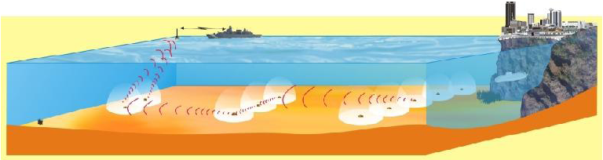

Static Scenario: ISR & interference sensitivity
1-2 nm
5 nm
5 nm
Goal:
Detects and reconstructs the intruder movement.
Communicates the detection data through robust links.

Slide 5
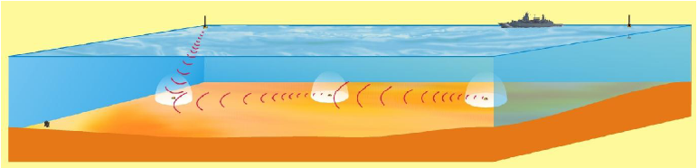
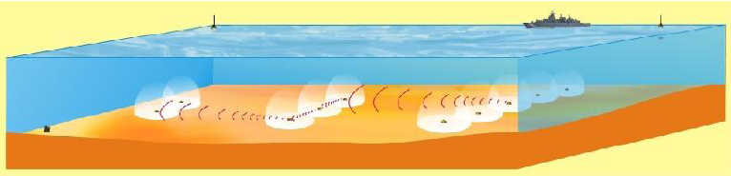
Robustness defined by the German navy
A single multi hop link is not robust in case of failure of components (e.g. burial of bottom nodes, lack of energy, jamming, malfunctions, high transmission losses, …)
Redundancy in communication links;
Network with high route diversity is needed.

Slide 6

Explore the route diversity (1)
Requirements:
Ctrl packets to update the topology.
Small detection data packets.
Low bit Rate.
Realization:
Source routing protocol.
Multipath.
Cooperation between the sinks.
Redundant information

Slide 7
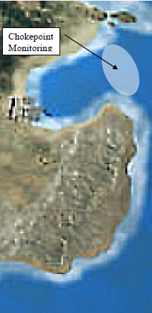
Explore the route diversity (2)
sink1
Area1
100 nm²
submarines transiting chokepoints or exiting harbour areas
Area2
100 nm²
sink2

Slide 8
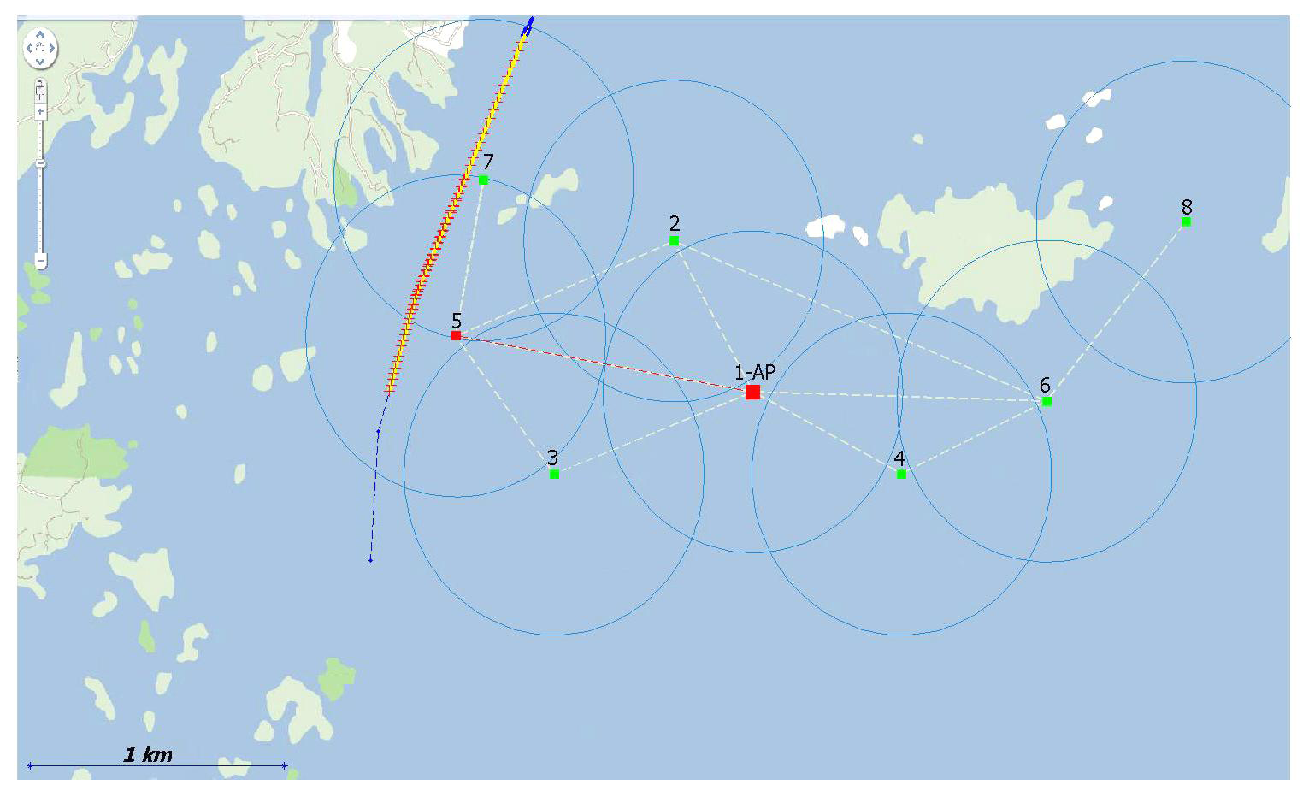
Hybrid Scenario: Communication between moving nodes via stationary stations for control application
“In many cases, moving underwater nodes will need to be covert, but also need to transmit information back to a command center…” .
cmd
Command center
“Sink”
Intermediate node
“stationary station, buoys,…”
Mobile nodes
“AUVs”
report

Slide 9
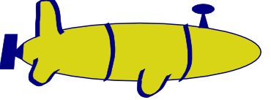
Hybrid Scenario: Communication between moving nodes via stationary stations for control application
AUVs
Stationary stations
Covert trajectory
Cmd center
V<=8 kts

Slide 10
Hybrid Scenario: Communication between moving nodes via stationary stations for control application
Node 5 and 7 detect the intruder
Report to the cmd center (sink)
Cmd center takes the appropriate control decision and replies to the stationary stations
AUVs collect the new control information…

Slide 11
Hybrid Scenario: Communication between moving nodes via stationary stations for control Application
Topology:
One or multiple AUVs.
The grid area is divided into cells.
Each cell contains a stationary station.
AUV path should be covert from any other node (intruders, enemies,…).
Stationary nodes position should not be necessary covert.
Communication protocol:
  command center -> AUVs : ctrl packets (128 bits).
  AUVs -> command center : data packets (2048bits).
Each AUV collects packets from a specific set of nodes located in a cell.
Ctrl pkts are broadcasted hop-by-hop to specific nodes then to the AUV.
Data packets are generated as a report event and sent through static nodes after a period (wait until the AUV leave the cell).

Slide 12
Parameters
 | Scenario1 | Scenario2 | Scenario3
Type | Static | Static | Hybrid
Country | German Navy | Italian Navy | Norwegian Navy
OperArea size(nm²) | 10*10 | 10*10 + 10*10 | 10*10
Depth | Littoral | Littoral | Littoral (nearly 100 m up to 150 m)
Node distance (nm) | 0-3 | 0-5 | 0-5
Mobile Node speed | Drifting | Drifting | 0-8 kts
Intruder speed(km/h) |  | 0 | < AUV speed
AUVs | 0 | 0 | >=2
Packet size: | (<128) | (<128) | (128-2048)
Message size | Up to 1Kbyte | Up to 1Kbyte | Up to 10Kbytes
Latency | 5min | 5min | 5min

